Slide 1

Construction project management
Presented by:
Basia E. Dellaripa, AC
Certified Associate Constructor

Slide 2

Construction Project Management Stages
Design
Bidding
Pre-Construction
Construction
Commissioning
Owner Occupancy

Slide 3
Course Objectives
Project Documents
Delivery Methods
QA/QC
Sustainable Materials
High-Performance Building Codes
Ethics

Slide 4
Learning Outcomes
Bid Searches/Bid Documents
Project Documents
Terminology/Acronyms
LEED® Checklist

Slide 5
Methods and Grading
Methods
  Lectures
  Class Discussions and Participation
  Student Presentations
Grading
  Attendance & Class Participation
  Assignments
  Midterm & Final Group Project

Slide 6
Resources
eBid Portal Websites
Contract Documents
Blackboard Learn
Hand-Outs
Industry Websites

Slide 7
Project Documents
Plans and Specifications
Bid Documents
Contract Documents

Slide 8
Delivery Methods
Design-Bid-Build
Design-Build
Construction Management Agent
CM-At-Risk

Slide 9
QA/QC
Quality Assurance
  Pre-Construction Phase
    Design
    Specifications
    Functional Performance
  Construction Phase
    Inspections
    Monitoring
    Assessment

Slide 10

QA/QC
Quality Control
  Construction Phase
    Communication
    Conformance
    Document Control
    Procurement
    Testing
    Inspections
    Commissioning
Communication
Completed Project
Commissioning
Conformance
Pre-Con
Inspections
Procurement
Testing
Document Control

Slide 11
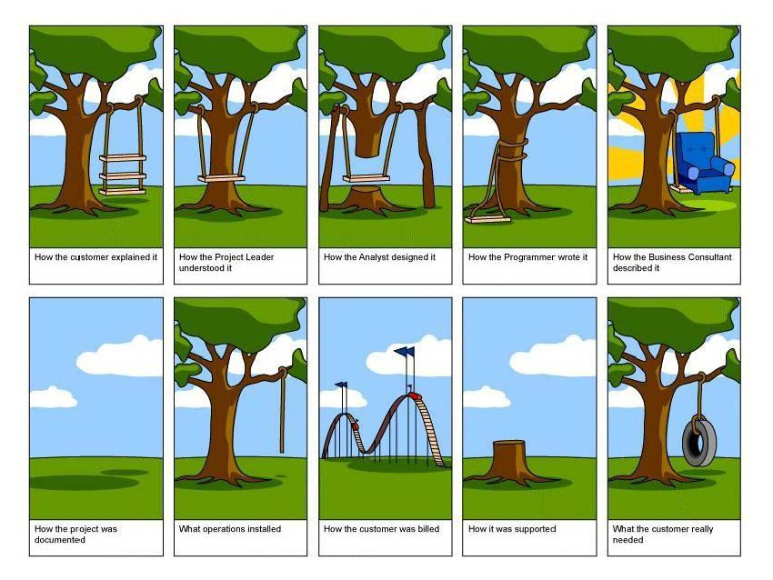
Communication

Slide 12
Conformance: High-Performance Building Codes
Building
Fuel
M-E-P
Maintenance
Fire Prevention
Energy
Wildlife/Urban Interface
Performance
Existing Buildings
Zoning Regulations

Slide 13
Document Control
Working Documents
  Submittals
  Schedules
  Daily Reports
  RFIs
  Agency Reporting

Slide 14
Procurement: Sustainable Materials
Resource Efficiency
Indoor Air Quality
Energy Efficiency
Water Conservation
Affordability

Slide 15
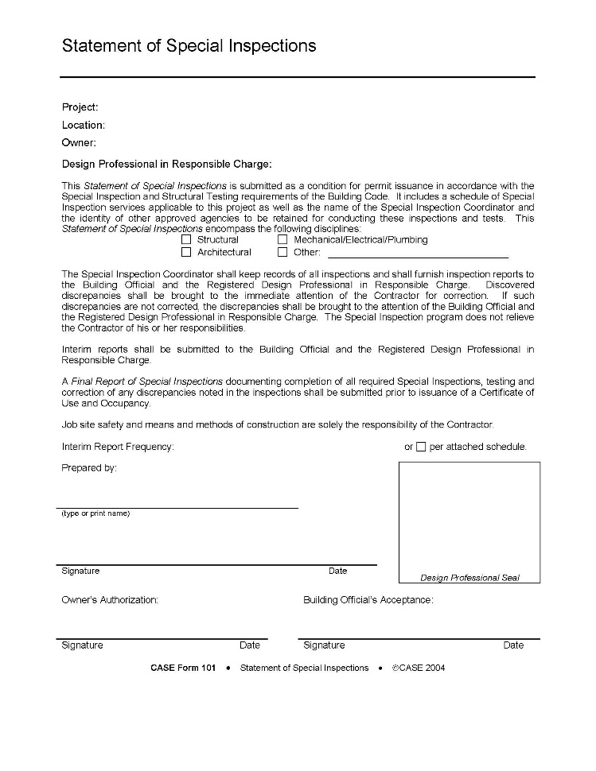


Testing and Inspections

Slide 16
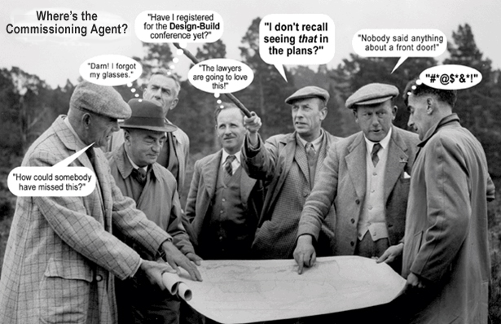
Commissioning

Slide 17
Ethics
Bid Rigging - Collusion
Bid Shopping
Disclosure
Front End Loading
Bribery
Compliance

Slide 18
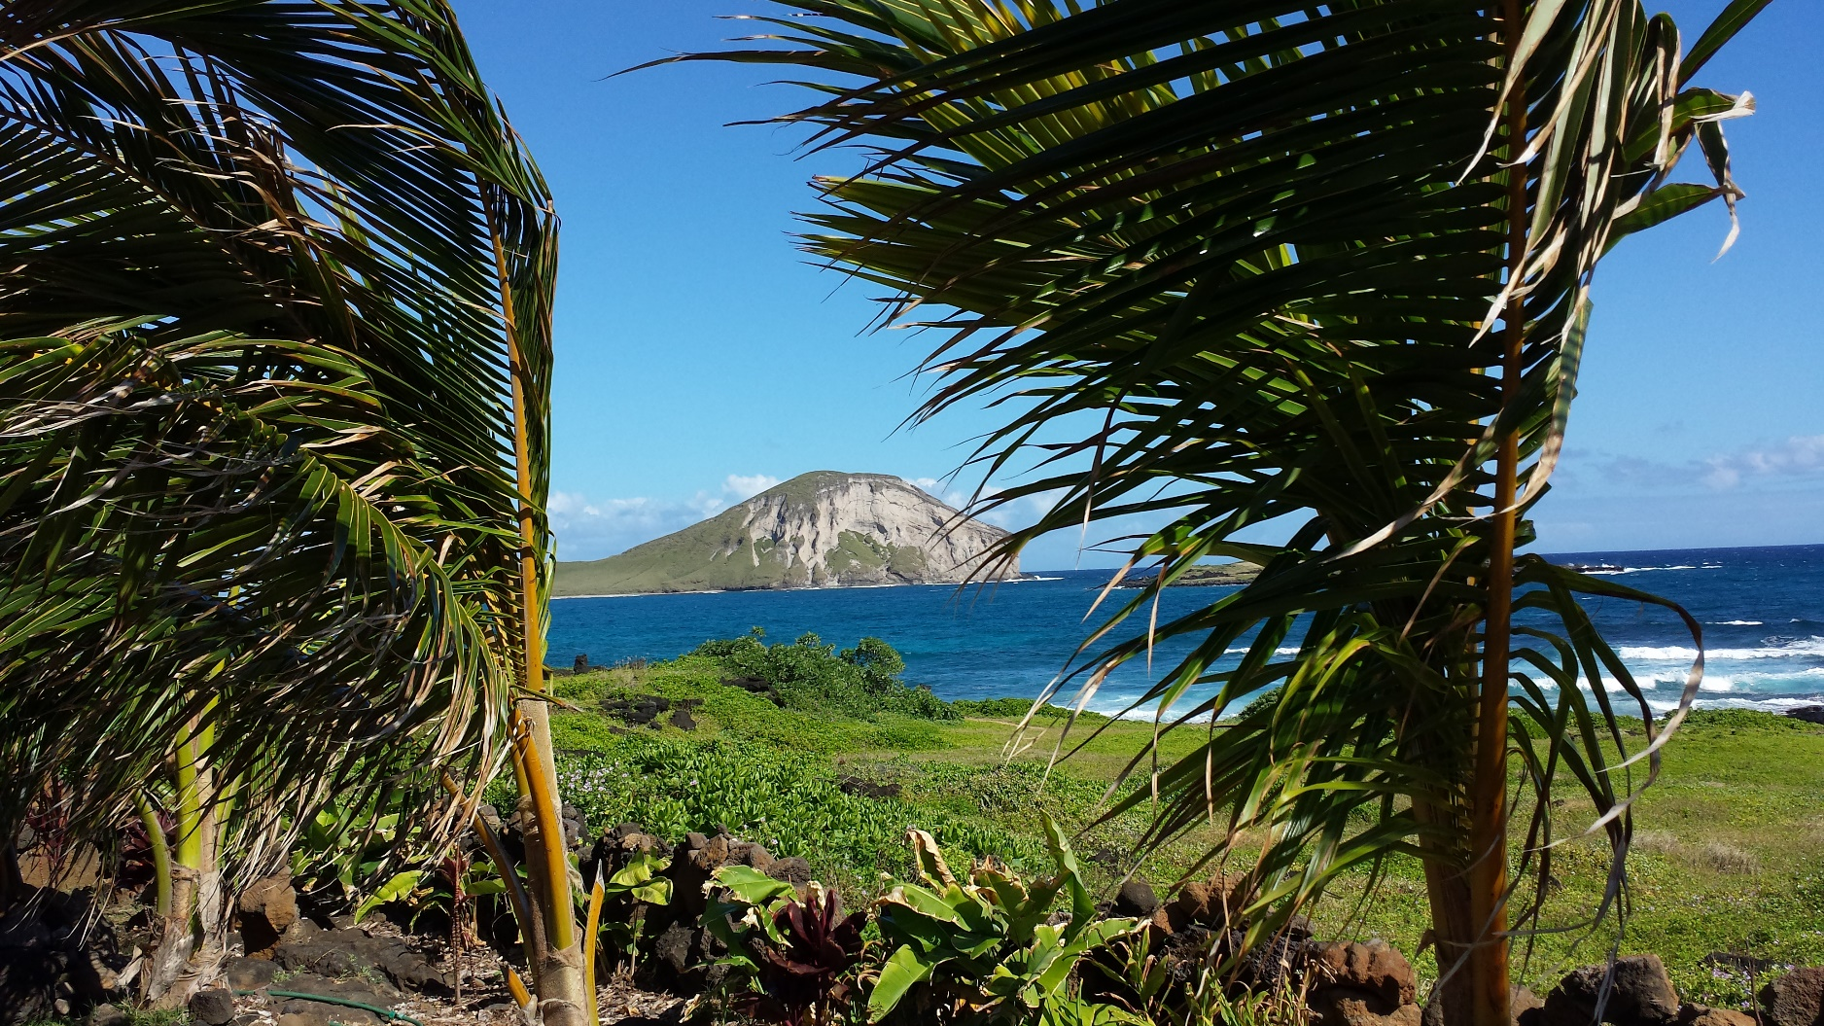
Mahalo

